Slide 1

EXPLORATORY DATA ANALYSIS >>> VIDEO GAME SALES
08/08/2020
PRISCILLA BAAH
PRINCE ADORKOR
RAYMOND BENTUM
RAYMOND NORMESHIE

Slide 2
Table of Content
Introduction
Hypothesis
Analytical Question
Detailed Process Description
Visualizations and Insights

Slide 3

Introduction
With over 16500 data points collected over a period of 40 years, what amazing insights can we derive from the video game sales market?

Slide 4
The Data
Our data set consists sales of video games across regions, genres, platforms and publishers for the entire 40-year period (1980 -2020)

Slide 5
Hypothesis
Before we set out to analyze, we made an important assumption to guide us:
Global video game sales increases over the years, with the North American region and the PlayStation Platform taking the highest shares.

Slide 6
Analysis Questions
To help conclude whether our initial assumption is true or not, we asked these questions:
What is the trend of global video game sales over the years?
Which years had the highest video game sales?
Which region has the highest share of global video game sales?
What is the trend of video game sales in North America over the years?
What is the most popular platform among gamers?

Slide 7
Question 1: What is the trend of global video game sales over the years?
ffg

Slide 8
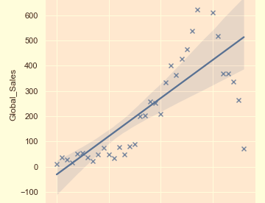
Q1. What is the trend of global video game sales over the years?

Slide 9
There is no linear trend in the distribution of global sales for the video games over the years.
The global video games sales rises slowly in the initial years(1980 to mid 1990s).
From the mid 1990s, it sharply increases and reaches an apex in 2008. From there, there is a sharp decline over the years.

Slide 10

Question 2: Which years had the most video game sales?
ffg

Slide 11
…2008
With over 684 million video game copies sold, the year 2008 recorded the highest number of video games sold in the 40-year period.

Slide 12
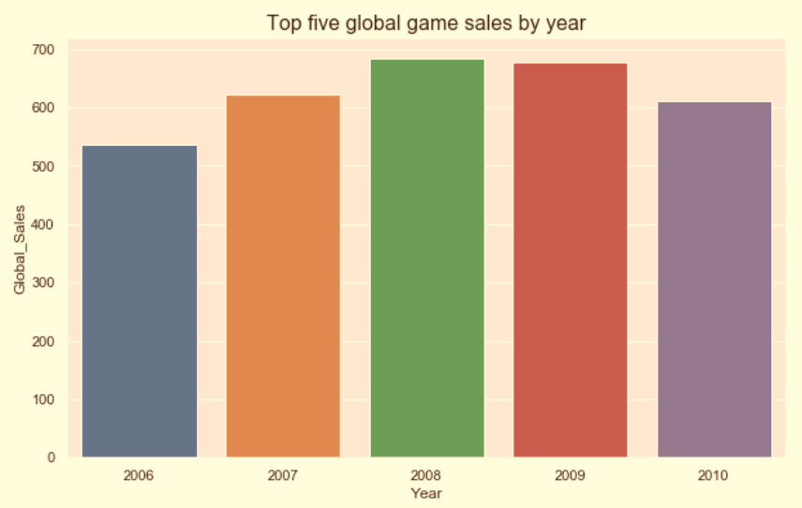
All the years in the top 5 were from the last decade.
This is an indication that the 2000s were a good time for the video game industry in terms of sales.

Slide 13
Question 3: Which region has the highest share of global video game sales over the years?

Slide 14
… North America
Among the regions North America recorded the highest sales at $4392.68 million, representing almost 50% of the total global video game sales

Slide 15
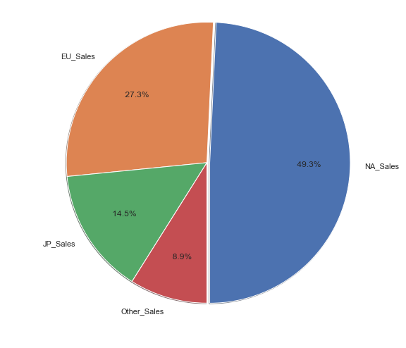
North American Sales have the highest share of global sales.
Almost half(49.3%) of video games that have been sold since 1980 were sold in North America.
Also, close to a third of the sales occurred in Europe, with the rest being shared between Japan and the rest of the world.

Slide 16
Question 4: What is the trend of Video game sales in North America over the years?

Slide 17
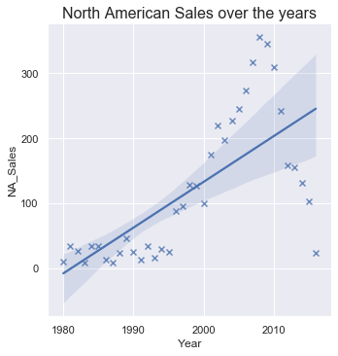
North American sales exhibit similar behavior to the global sales when compared to the years.
North American sales increase slowly in the 1980s through to the middle of the 1990s.
From there it increases rapidly, reaches an apex in 2008 and declines sharply afterwards.

Slide 18
Question 5: What has been the most popular video game genres/platforms over the years?

Slide 19
The PlayStation platforms (PS 2 and PS 3) are the most popular choice of video game platform among almost half of gamers(42%)
… PlayStation

Slide 20
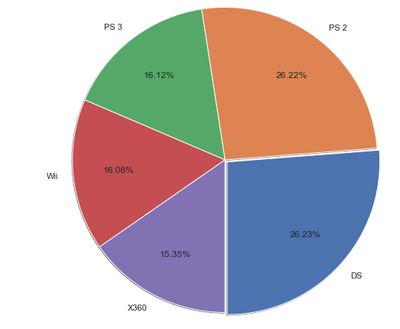
DS seem to have the highest share of global game sales(26.23%).
However the PlayStation platforms PS 2 and PS 3 have 16.12% and 26.22% of the global game sales shares. When combined, PlayStation has about 42.3% share of global video game sales.

Slide 21
Conclusion
From our analysis, was our initial hypothesis true?
… Yes and No!

Slide 22
Yes because?
As has been confirmed by the pie charts, North America indeed has the highest share(49%) of global video game sales as we assumed
PlayStation is also the most popular platform among gamers(used by 42% of gamers)

Slide 23
… And why No?
Well, we assumed that global video game sales increased over time, but from question one’s scatter plot, there seem to be no definitive trend in the global video game sales over time

Slide 24
Thank YOU!
…And that will be all from our analysis

